Slide 1

Project title:- Arduino Based Home Automation Using Bluetooth
Submitted in the partial fulfillment for the award of the degree of
BACHELOR OF ENGINEERING
IN
B.E_CSE_SPECIALIZATION_IN_INFORMATION_ SECURITY_AIT_APEX
Submitted by:
NAME OF THE STUDENT:- AMRITPAL KAUR
DHILLON
University Roll Number:- 22BIS80001
Under the Supervision of:
SUPERVISORS NAME:-RAVNEET KAUR
Department of AIT-CSE
DISCOVER . LEARN . EMPOWER

Slide 2
Outline/Contents of Presentation
1. Introduction
2. Block diagram
3. Explanation of Block diagram
4. Circuit diagram
5. PCB Layout
6. Software Flowchart
7. Component List
8. Application

Slide 3
Introduction to Project
Project Aim: To control electrical devices with an Android mobile.
Controlling technique: We have used Bluetooth technology in this project.
We need to install an application on our android mobile phone.

Slide 4
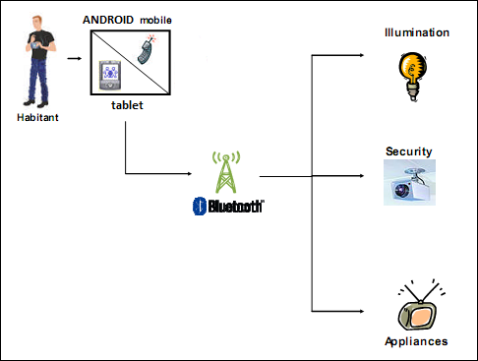

Slide 5
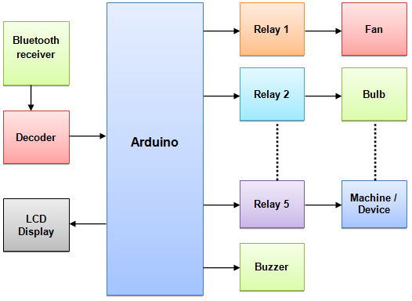
Block Diagram of the Project

Slide 6
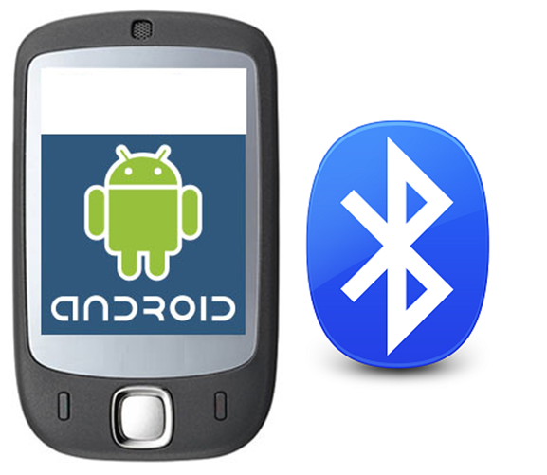
Transmitter / Controlling Unit
Bluetooth enabled Android mobile

Slide 7
Block diagram Description
1) Android mobile / Smart Phone:-
It consists of an Android mobile handset having Bluetooth. Also, the user needs to install an application on this mobile. This Android mobile sends commands using Bluetooth technology.
2) Bluetooth decoder: -
It consists of a Bluetooth decoder. It gives ASCII code output. This receiver enables wireless transmission& and reception of serial data. It has 10 meters range.

Slide 8
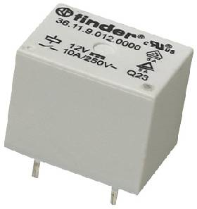
RELAY
Relay is used to control the on/off operation of the device. Relays are driven by the transistors. We are using a single pole double throw (SPDT) relay. The relay acts as a switch that is used to control the 230-volt AC supply. This relay can be used to turn off electrical appliances like fans, tubes, etc.

Slide 9
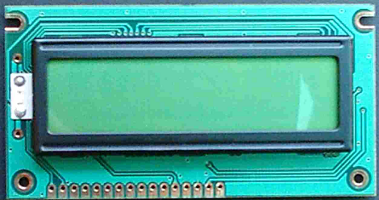
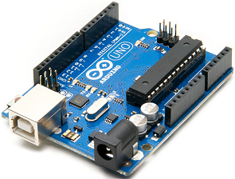
4) Arduino:- It is the major part and heart of the system. It controls all the inputs & and the controlling action to be taken at the output. We have used Arduino Uno.
5) Liquid Crystal Display:- It is an Alphanumeric Display. Used for displaying various messages. We have used 16 x 2 Alphanumeric Display

Slide 10
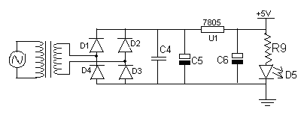
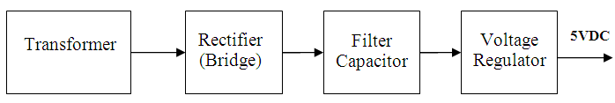
Power Supply Module
Power supply gives +5v supply to the circuit. It consists of four stages namely transformer, rectifier, filter, and regulator.

Slide 11
Transformer: Step-down transformer takes 230v AC input & gives 15v at output secondary
Bridge rectifier: It consists of four diodes & rectifies this 15v AC, which converts the AC wave into the fully rectified wave.
Filter capacitor: It converts the fully rectified wave into the DC wave with some ripple.
Voltage Regulator: It is the last stage. It removes the entire ripple and gives pure DC. The LED is connected to indicate that the power supply is ON

Slide 12
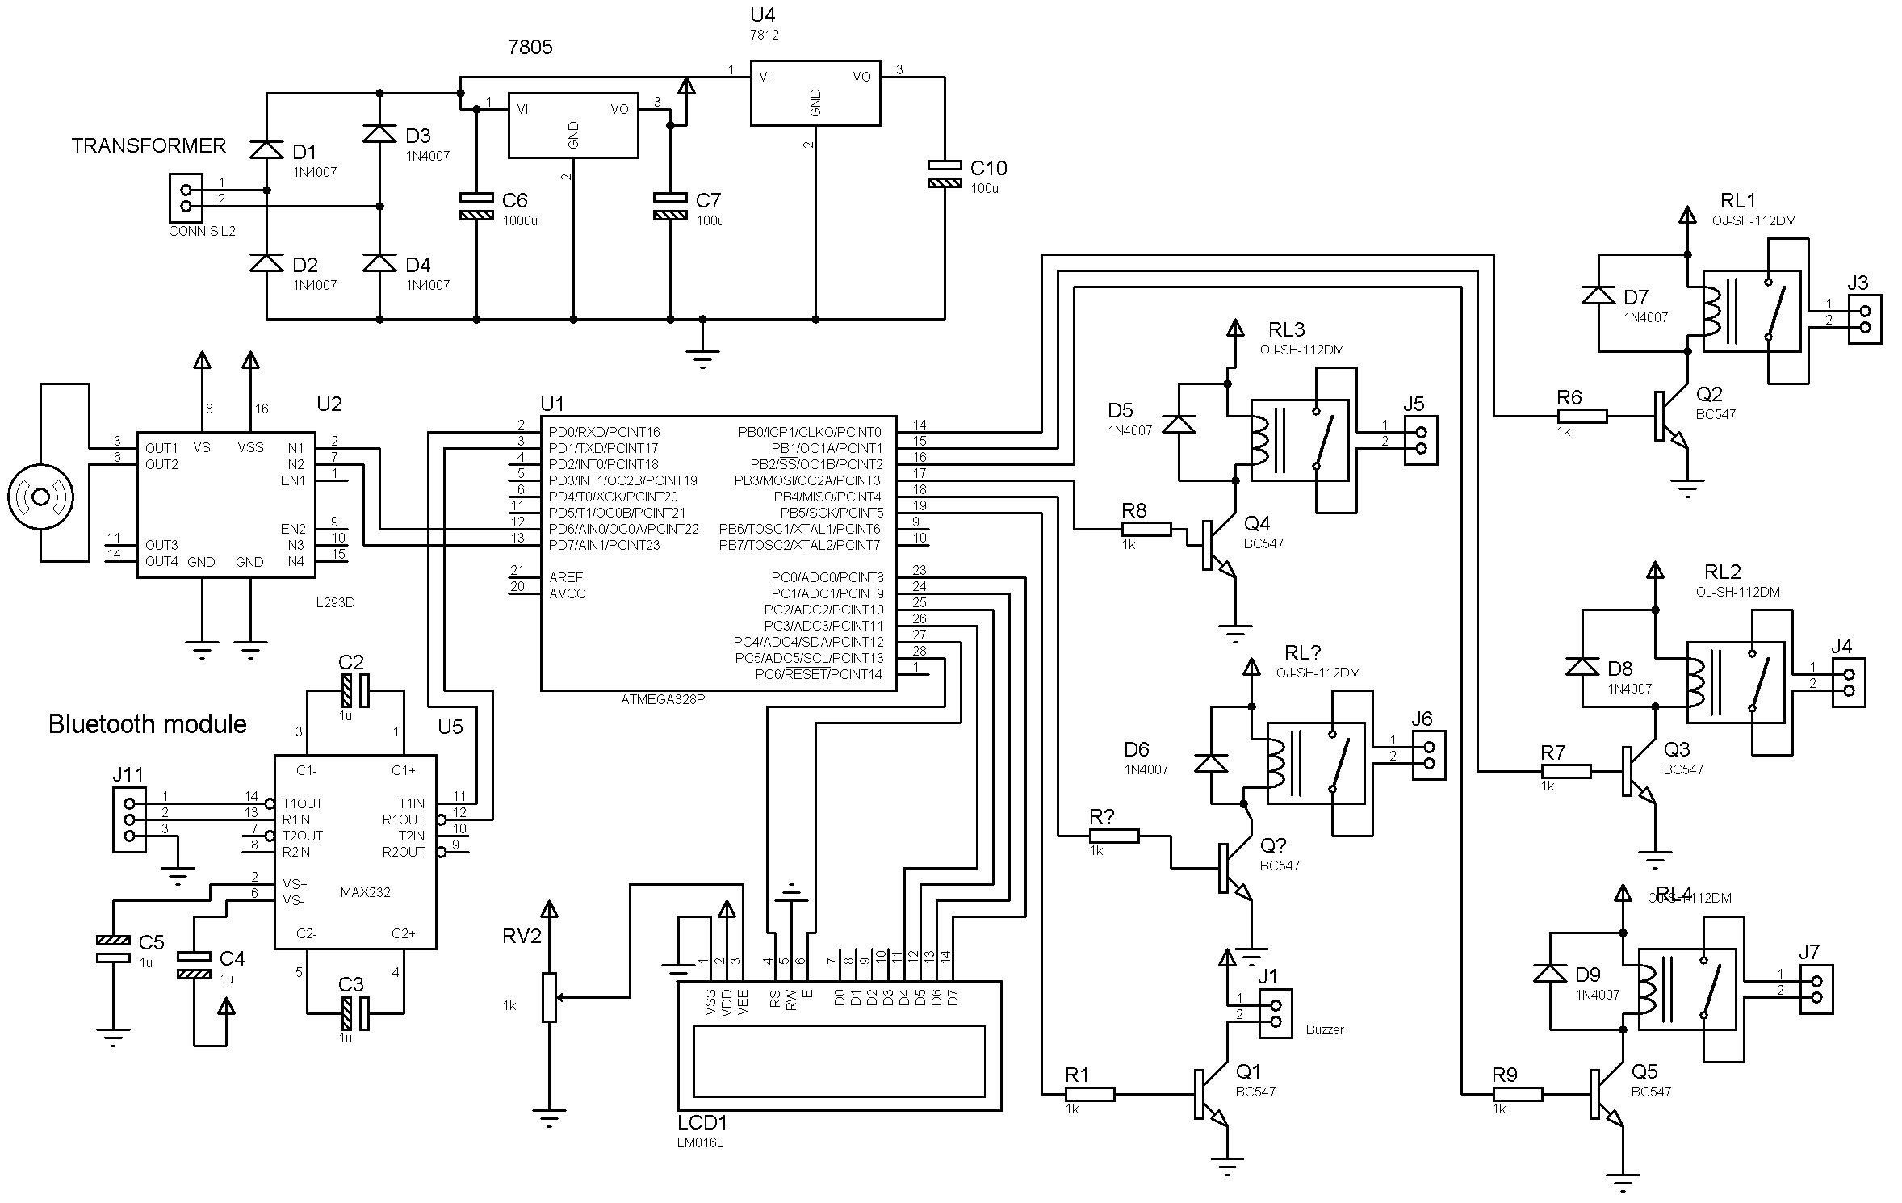
CIRCUIT DIAGRAM

Slide 13
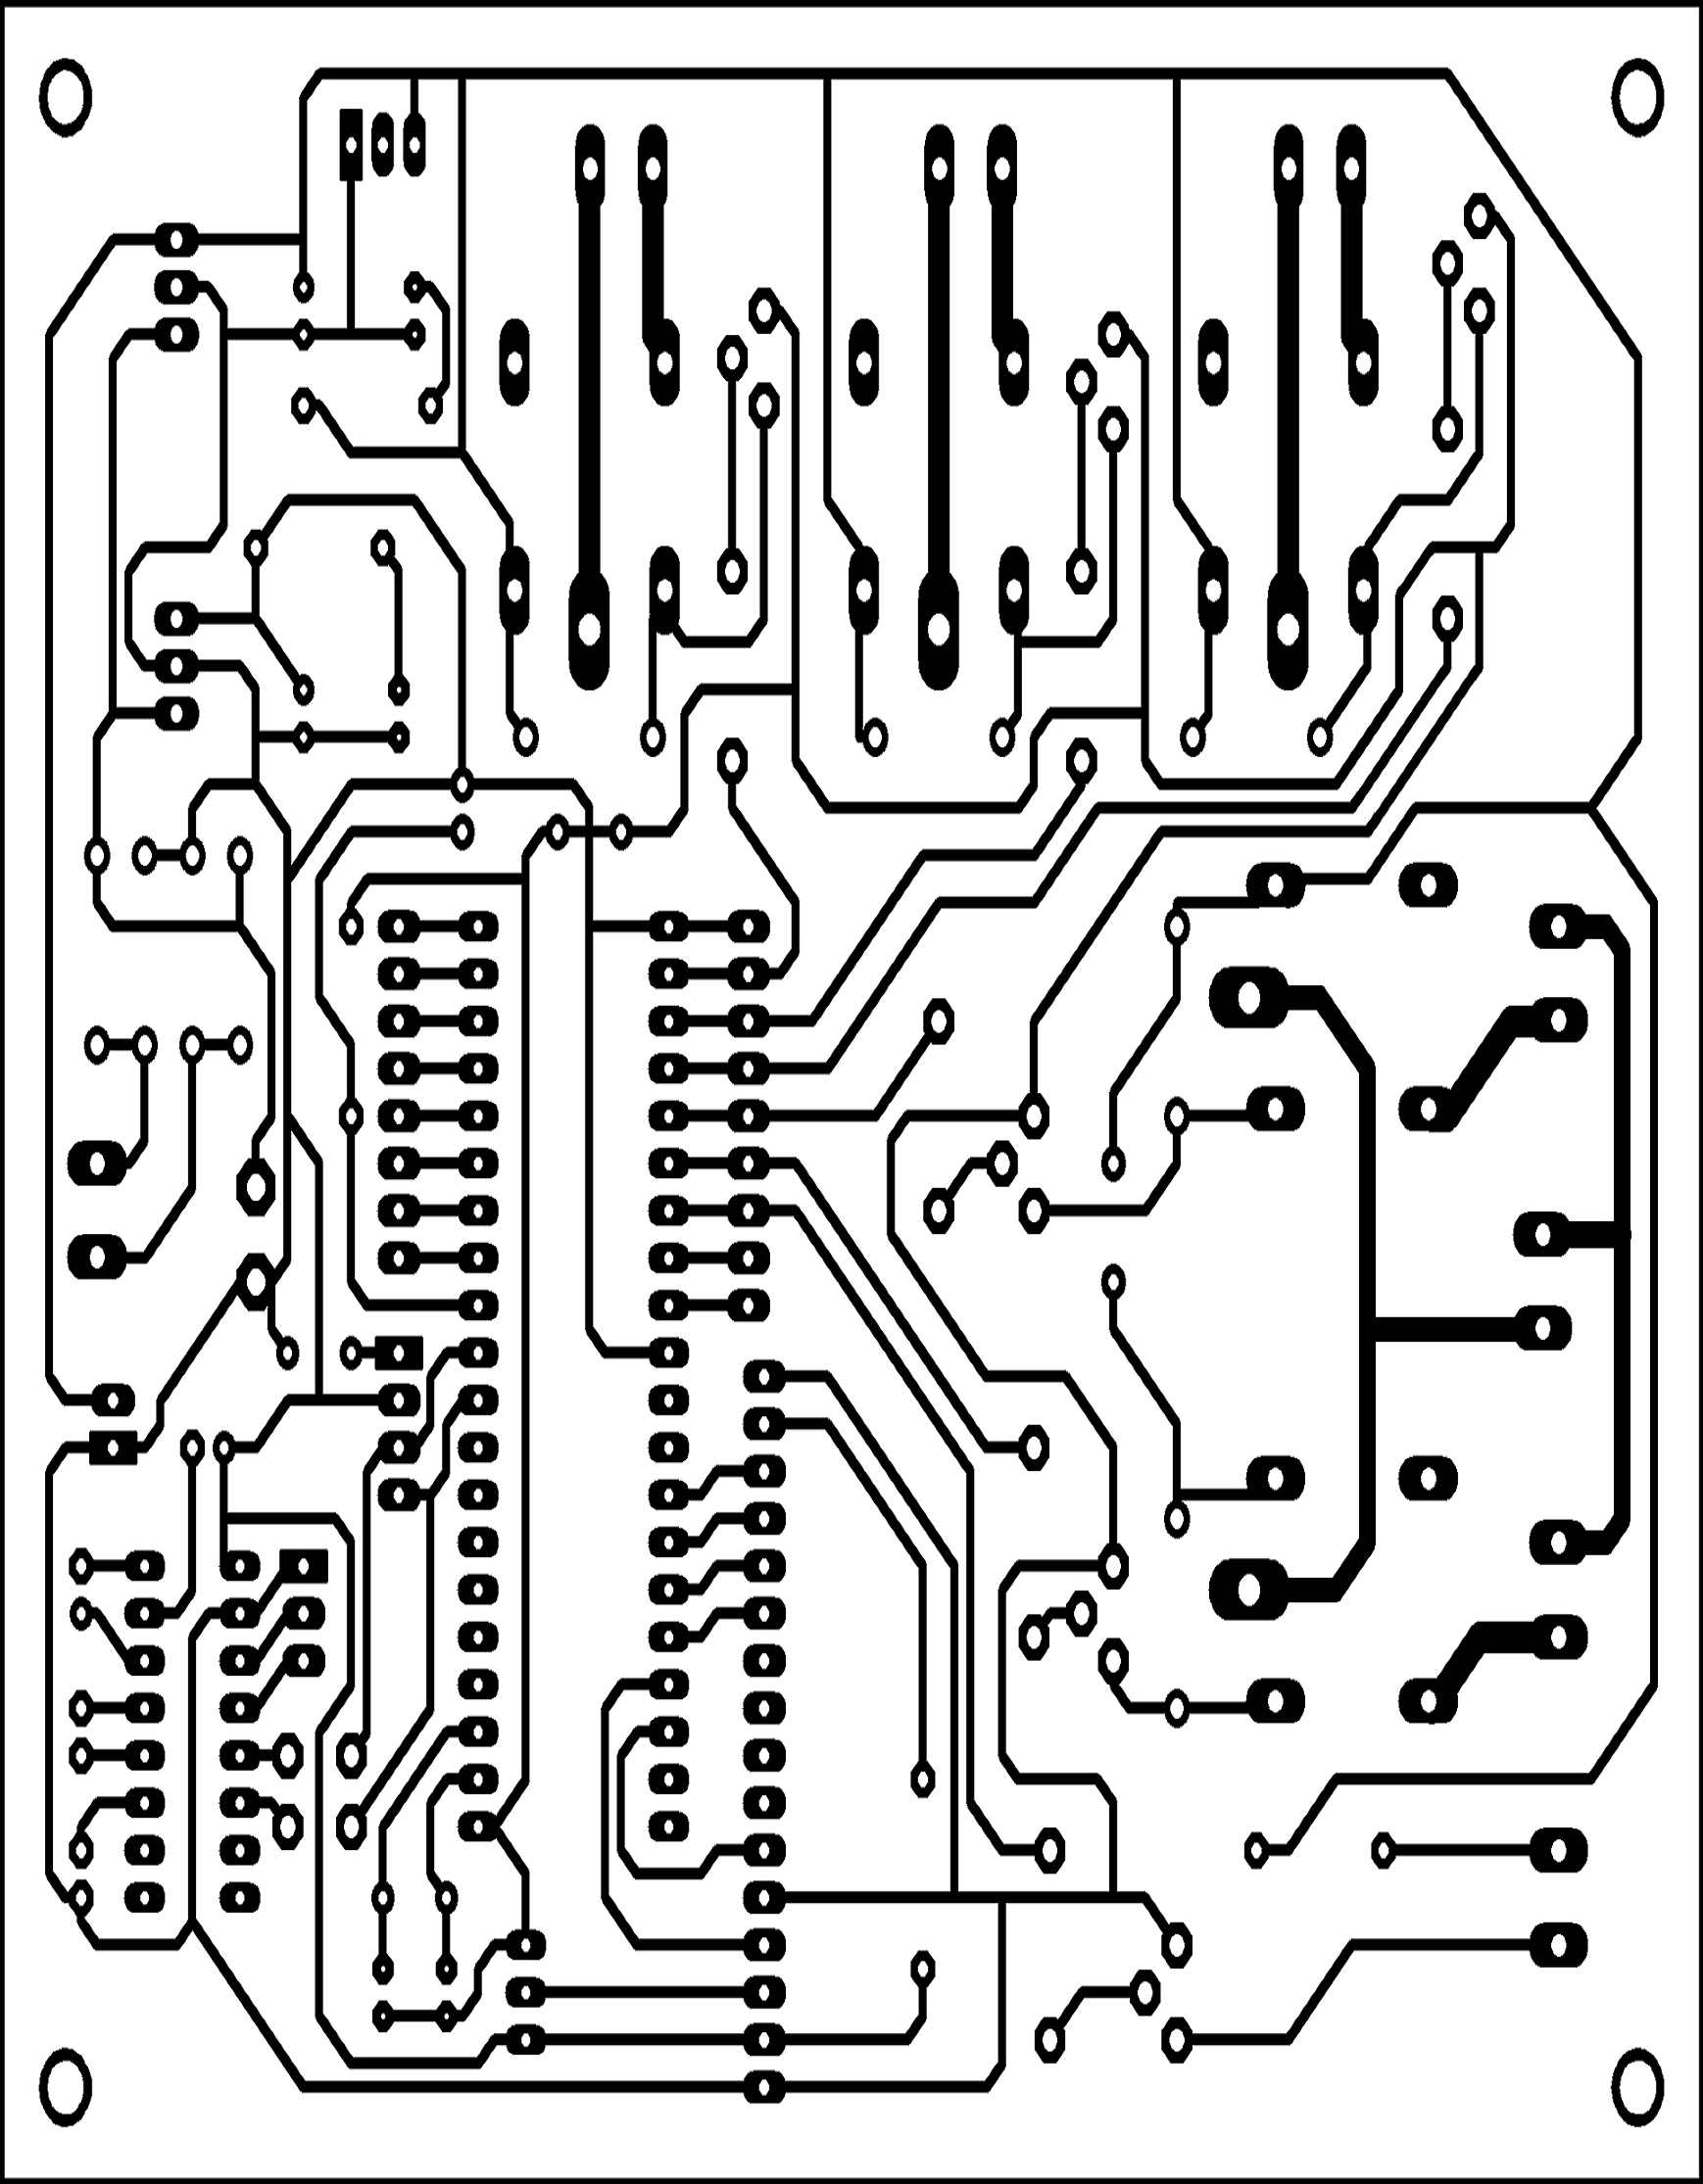
PCB LAYOUT

Slide 14
PCB making procedure
FABRICATION: The circuit is designed and layout is done on the copper-clad side. Spaces are provided for holes to insert the respective components.
ETCHING: Copper-clad PCB is etched with ferrous chloride solution. Copper remains if a varnish coating is there. Then it is washed with water and oxalic Acid.
DRILLING: PCB Holes are drilled with tiny drill bits. The drilling is performed by automated drilling machines.
Plating and Coating: PCBs are plated with Solder, Tin, or Gold over Nickel as a resist for etching away copper.the

Slide 15
Software used in our Project
EAGLE Software: It is used for PCB design, it includes Schematic Capture, Board Layout, and Auto-router.
EAGLE has the following 2 sections:
1) Schematic capture: For designing circuit diagrams. Parts can be placed on many sheets and connected through ports.
2) PCB layout: It allows auto-routing to automatically connect traces based on the connections defined in the schematic.
Arduino IDE software: It is used for Arduino Programming Software. It has a compiler designed specifically for the Arduino series. It converts a High-Level Language source code (written in embedded C language) into its object code. Then a linker is used to create an absolute object module suitable for your circuit.

Slide 16
Testing and Trouble shooting
Problem crop up:
1) The Bluetooth receiver was giving incorrect results & and errors
2) LCD was not showing any message.
How problems are rectified:
1) We have paired the Bluetooth receiver with the Android mobile
2) The potentiometer connected to the LCD was adjusted to set the contrast of the LCD.
Testing procedure: Verified design is correct & and prototype is built to design drawing. This is done by writing several small programs, basic programs & and building on the demonstrated success of each.

Slide 17
Component List
Arduino UNO
7805
7812
BC547
TRANSFORMER
CAPACITOR
DIODES(1N4007)
RESISTORS
DC Motor- 30 rpm
LCD Display
CRYSTAL
LED
RELAY
POT
LCD CONNECTOR
IC SOCKETS
CONNECTORS
Bluetooth receiver

Slide 18
Applications
Home automation - This project can be used to control various devices in the Home. It is used to control or switch on any electrical appliance.
Can also be used for security purposes after modification (we can control the gate system or we can interface a wireless camera and control it using our mobile)
The electric grid could be controlled remotely.
Automatic production machinery could be controlled even during odd hours with your mobile phone.
Industrial Automation– To control the status of industrial appliances.
To control (ON/OFF) the home appliances according to their status when we are going away from home.

Slide 19
Conclusion
With the knowledge of new techniques in ‘Electronics’ we can make our life more comfortable. One such application of electronics is used in “Home Appliances Controlling using Android Mobile via Bluetooth”
We conclude that the various devices in the home or industry can be controlled using our Android mobile phone.
We feel that our project serves something good to this world and we like to present it before this prosperous world.

Slide 20
Thank you

